Slide 1
Welcome to the
Synthetic Organic Chemistry
group
Floris Rutjes
April 2026

Slide 2
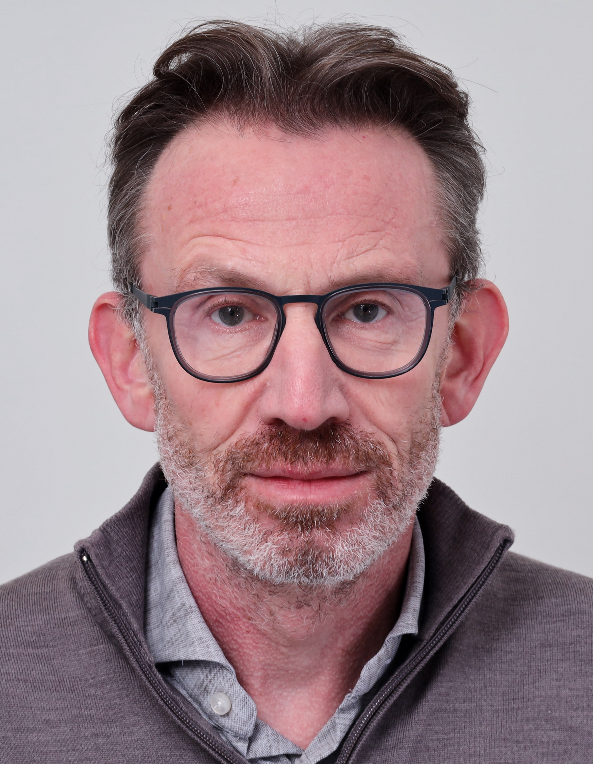
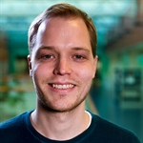
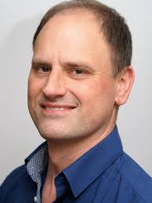
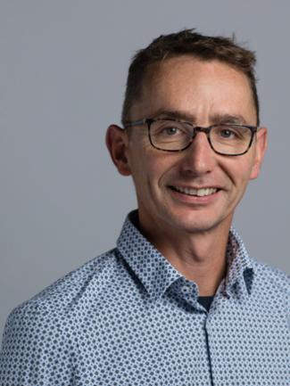
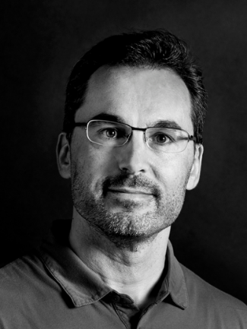
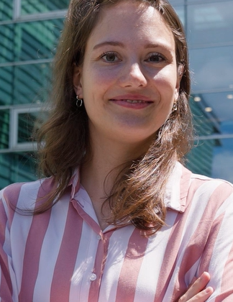
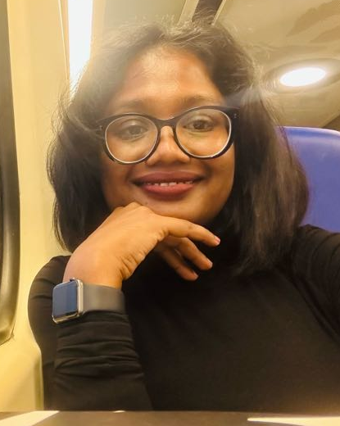
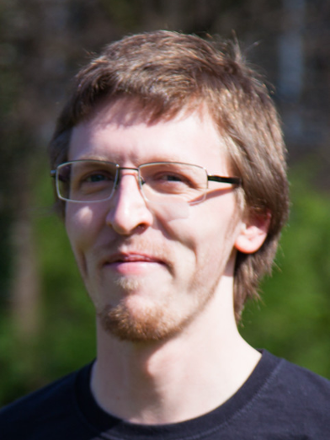
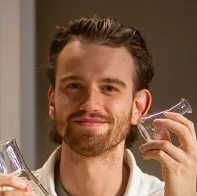
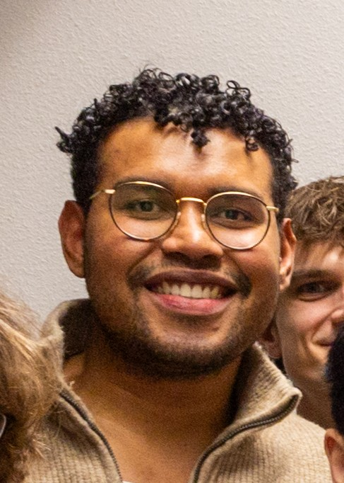
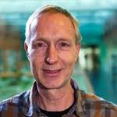
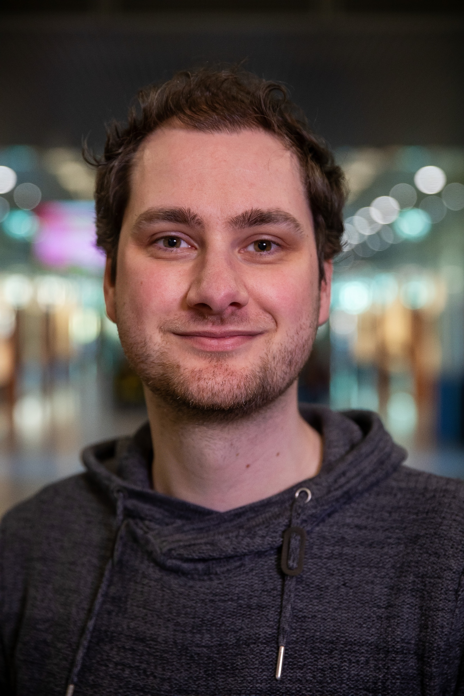
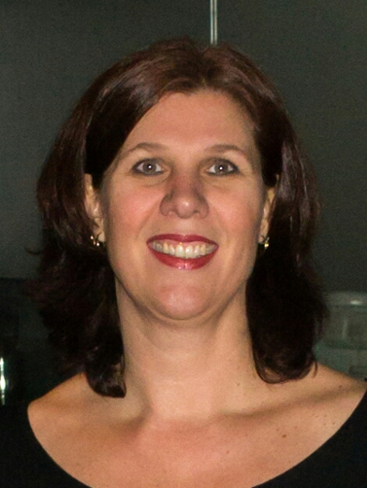
Synthetic Organic Chemistry group
Floris Rutjes
Thomas Boltje
Paul Kouwer
Dennis Löwik
Dani Blanco
Miriam Porzberg
Nuwanthi Kumarage
NMR
Jan Zelenka
MS
Samuel Bosma
Ordering consumables, equipment
Hernando Tuñon
Technician (MERC) consumables
Jan Dommerholt
Technician, ordering consumables
Frank Veldhuizen
Technician
Marieke Egbertzen
Management assistant

Slide 3
General information
Location: Wing 03.1, Mercator III, Floor 3
Working hours: Mo-Fr, 08.30–17.00 h
Working in the lab is only allowed with employee supervisor present
Weekly Synthetic Organic Chemistry group meetings: Thursdays from 9:00-10:00 h
Attendance is mandatory
Most projects have weekly progress meetings: date and time varies
IMM colloquia: Tuesdays from 16-17 h (Theme 2 and IMM colloquium): add the Rutjes-group@ru.nl calendar!
  Attendance is mandatory
Much more information is available on a Wiki: https://wiki.synorgchem.science.ru.nl/

Slide 4
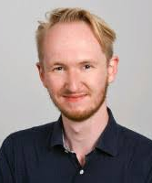
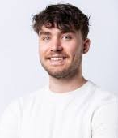
Before you can work in the lab
Download relevant information from the synorgchem drive:
  General Documents > Forms new students>
    Checklist new members 2026
    Internship Form - Internship RU students – 2023
    Registration in wings Cluster Orgchem
    Registration new students
Send the forms to marieke.egbertzen@ru.nl (use your @ru.nl address), also access to the wings will be provided
Carefully read the checklist
Lab coat
Lab goggles (Samuel/Hernando)
Safety-test -> Florian Ort, Milan Hoffmann
You have to pass the safety test before you can do any labwork!
Electronic lab notebook (ELN) Chemotion -> Dani Blanco

Slide 5
Data management
Why?
  For your own report
  For possible papers or patents
What do we need?
  For papers: prove for chemical structure, traceability of synthesis route
  For patents: date and person who did the experiment, reviewed data. For bio-active compounds: batch-traceability and bio-assays.
So for all compounds:
  Yields
  LRMS (already described compounds, Fleet/Max), HRMS (novel compounds, Jan Zelenka)
  NMR: ¹H- en ¹³C-NMR + relevant hetero-nuclei (B, N, F, P etc.) and if needed 2D-NMR.
  TLC: R_{f} – values (including solvent system!)
  IR for specific functional groups
Share your notebook(s) with your supervisor and let him/her review all your experiments
For biological compounds:
  Batch traceability
  All raw data
5

Slide 6
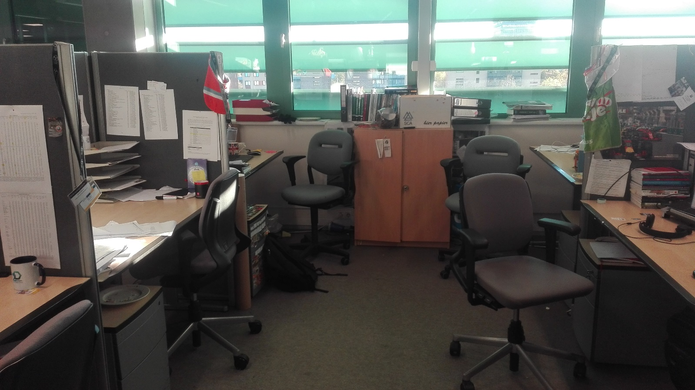
Workplace
Offices outside of labs
Workplaces for PhD candidates, post-docs, MSc and BSc students
Bring your own laptop
Chemical free! Therefore forbidden for lab coats, glassware, TLC plates, NMR tubes or mass vials

Slide 7
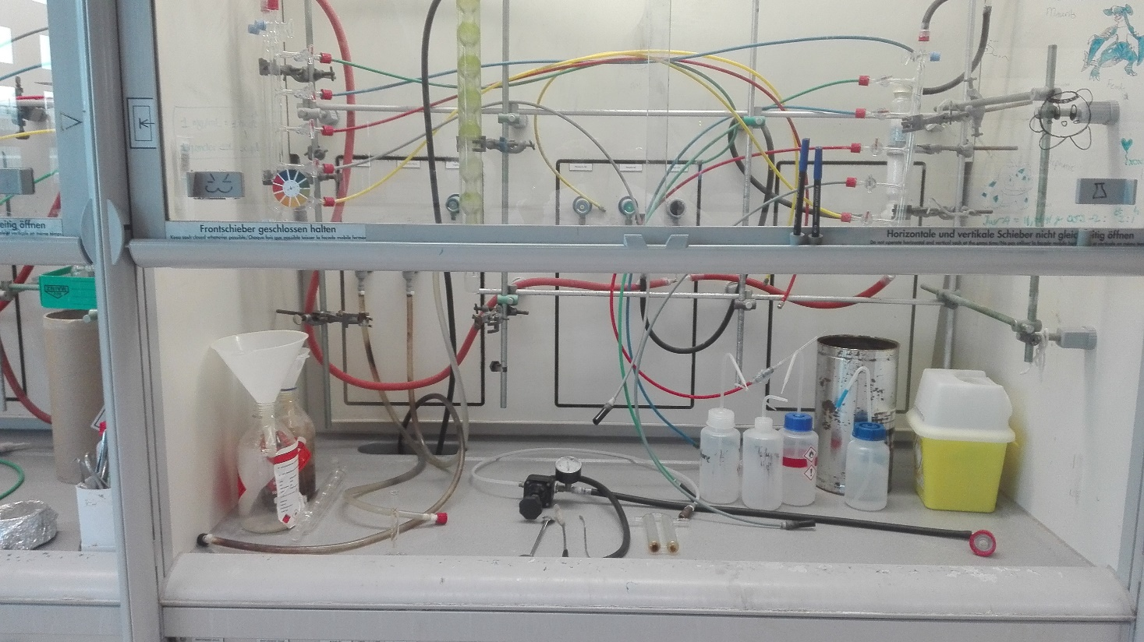
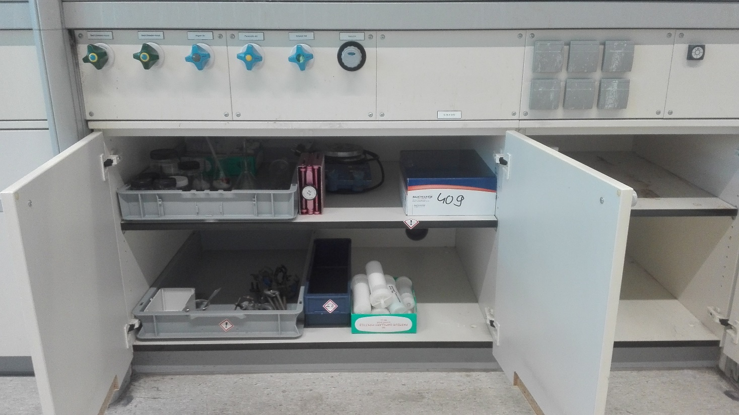
Fume hood
Cleaned before you started
2 Liquid waste container of max 1 liter
1 Sharp Safe
1 solid waste container
Silica waste in separate bin
Spray bottle for common solvents
Check schlenk set up – might need some cleaning
Underneath your fumehood
Storage of your chemicals in trays
Stirring plates and labjacks
Some personal glassware
At the end of your internship your fumehood should look like this again!

Slide 8
Lab guidelines
Efficient rotary evaporator use (quick as possible, turn off pumps after usage, fill waterbath if needed, clean after use)
Round bottom flasks are not for storage!! → transfer to pillenpotjes
Keep the general equipment tidy (balance, TLC stains, rotavap)
Clean your glassware (also the column tubes)
Replenish if stuff runs out, like solvents, solutions, salts, chemicals and consumables
For overnight reactions: make an overnight card
If things are ordered, help with transferring
Replace liquid waste containers when they are 80% filled!
If you have to stay late (after 17.00), discuss if some-one else is staying

Slide 9
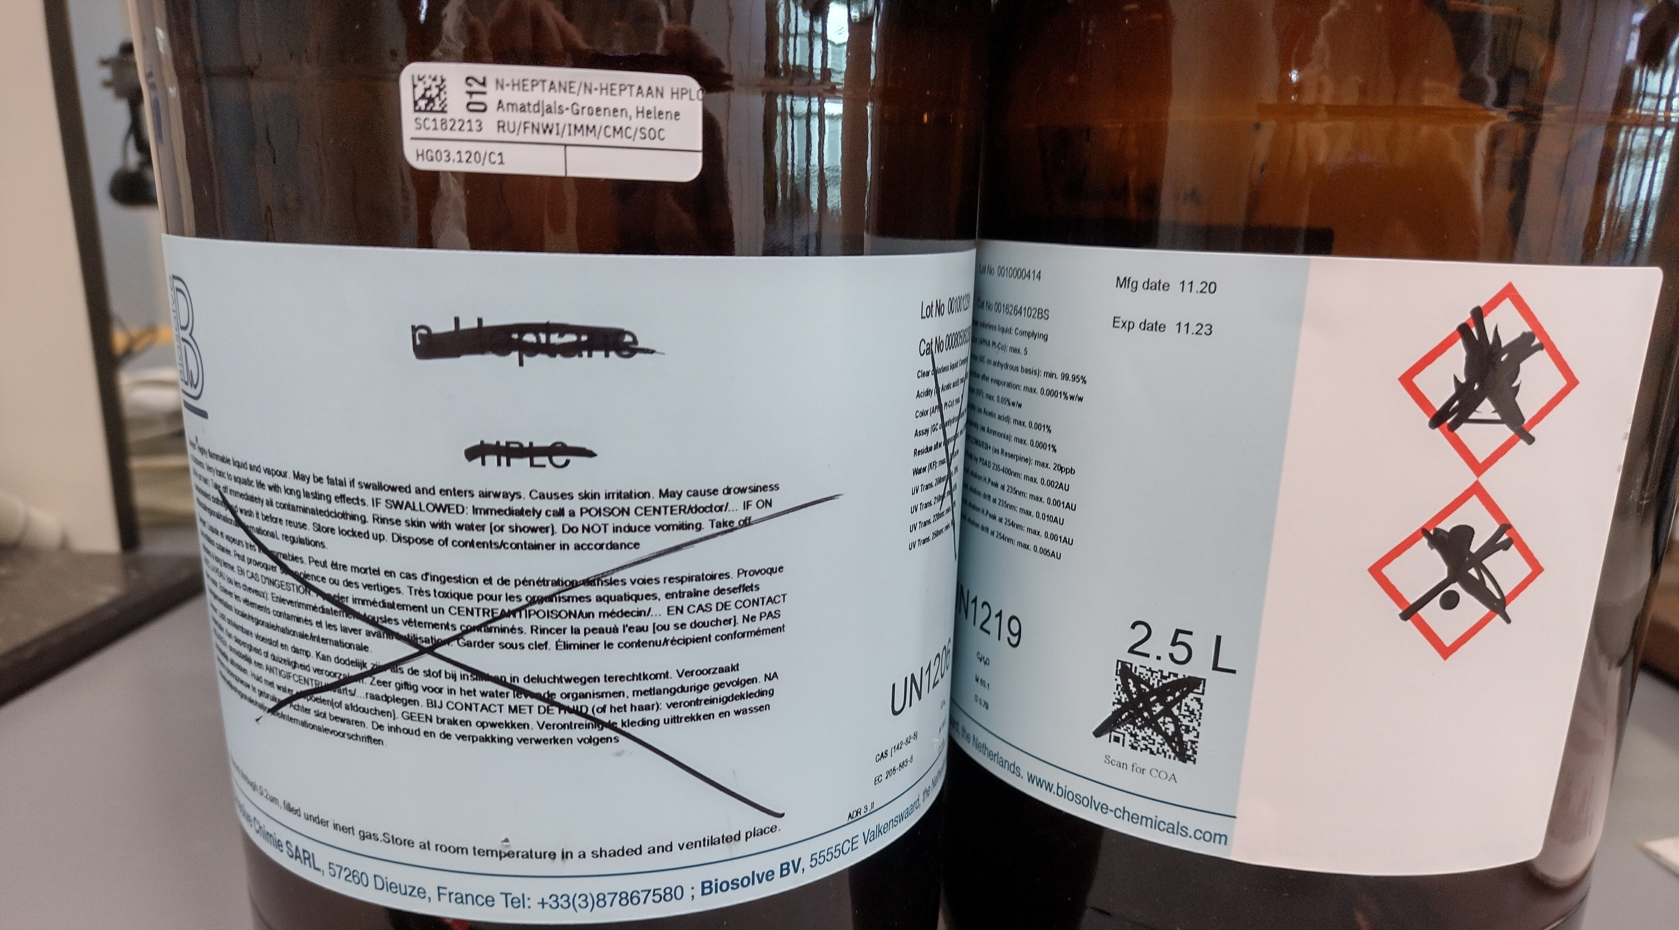
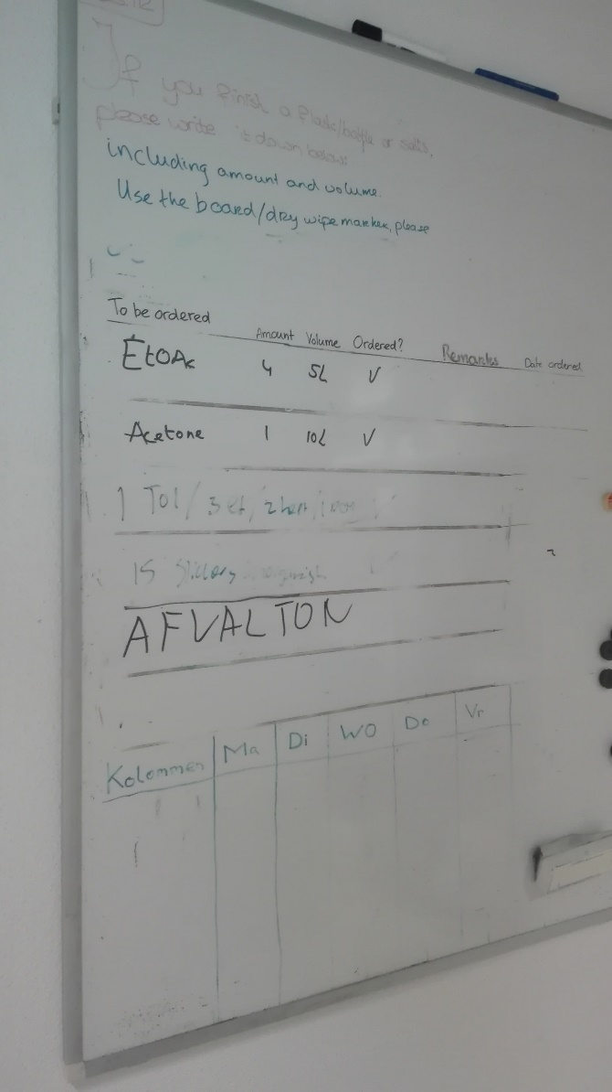
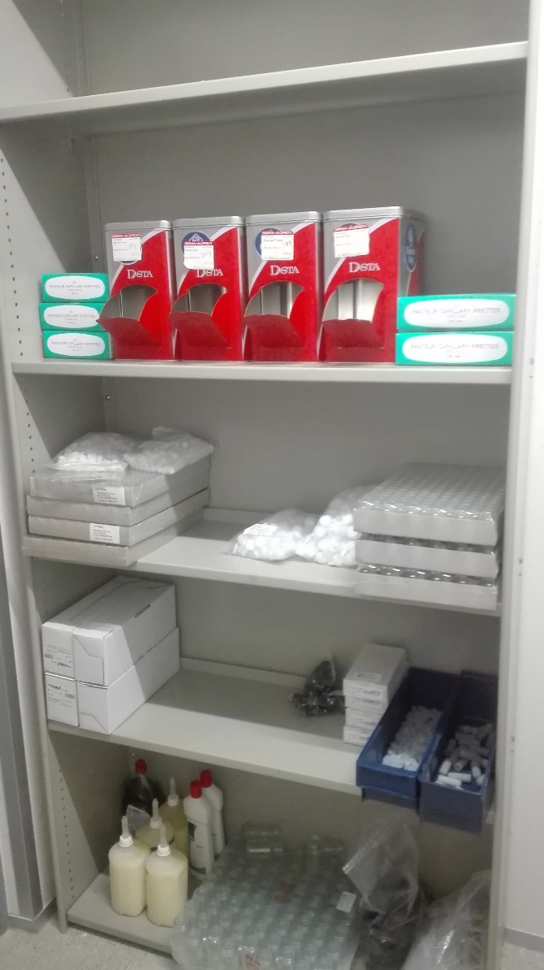
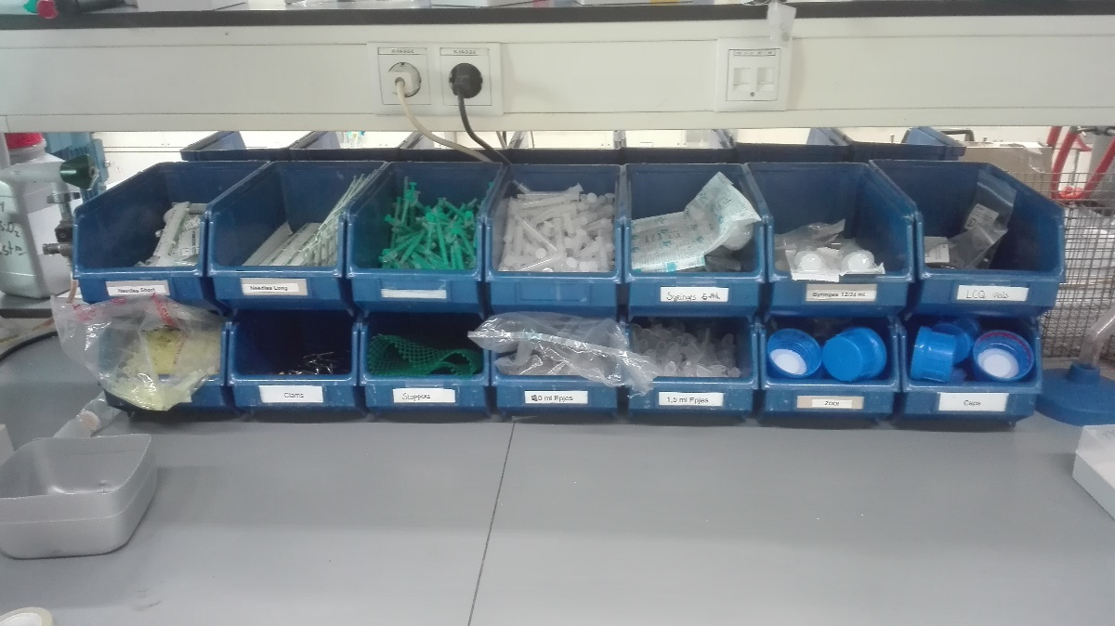
What if something is empty?
Chemicals
  Write it on the white board
  Rinse container and let rest evaporate
  Make labels illegible and remove sticker
  When dried out, in glass waste
  Sticker must be scanned out
Pipettes, vials, septa, paper, MS vials in the transfer room
Consumables (needles, syringes, etc) go to Samuel/Jan/Hernando
Any other things? Don’t know what to do? → Ask!
Notes:
Voorbeelden van een paar reactive intermediairen
Carbocation
Imminium ion
- Oxocarbenium ion

Slide 10
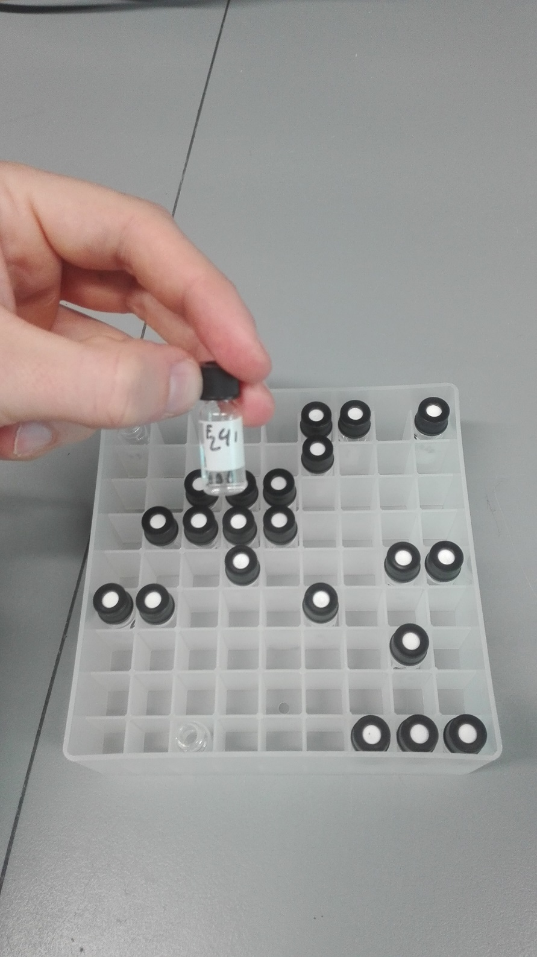
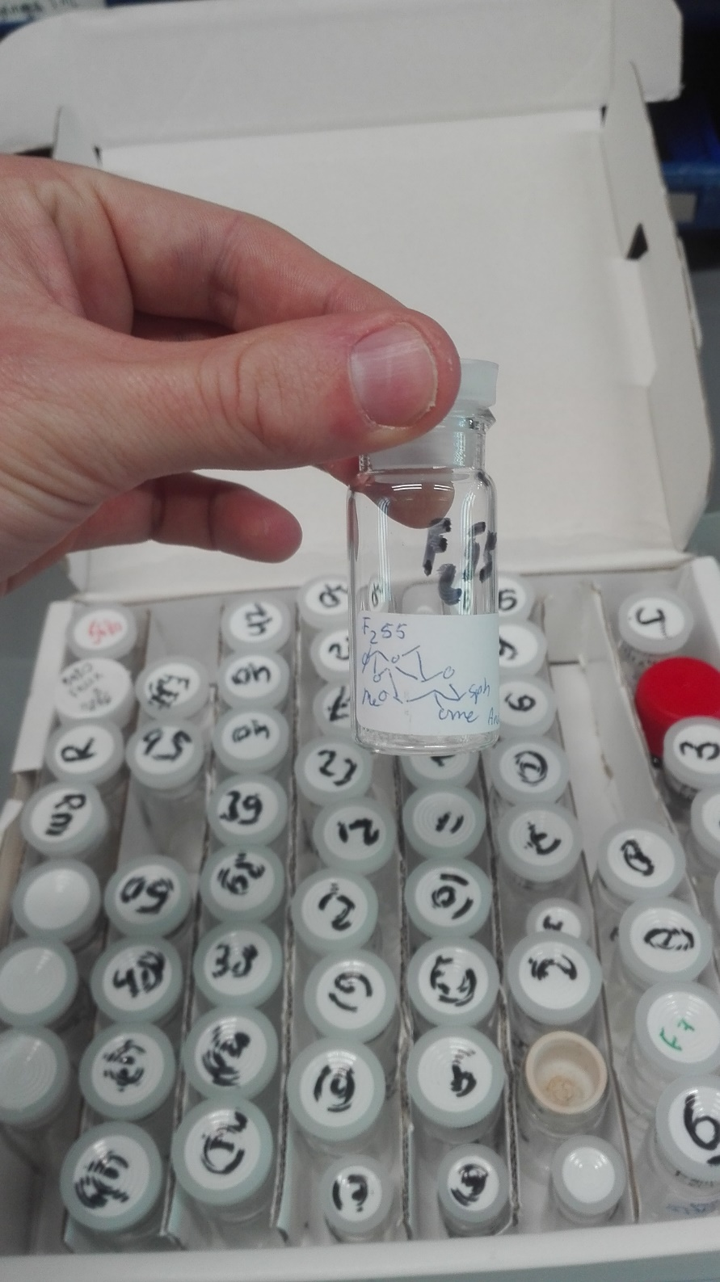
What to do if you made a chemical?
Mandatory analysis:
TLC, IR, 1H-NMR, 13C-NMR, HRMS
Store at least 5 mg of your compound
Compounds should be labeled with code and structure (right)
When storing TLC / mass vials, use compartimental system (left)
Store only pure compounds!

Slide 11
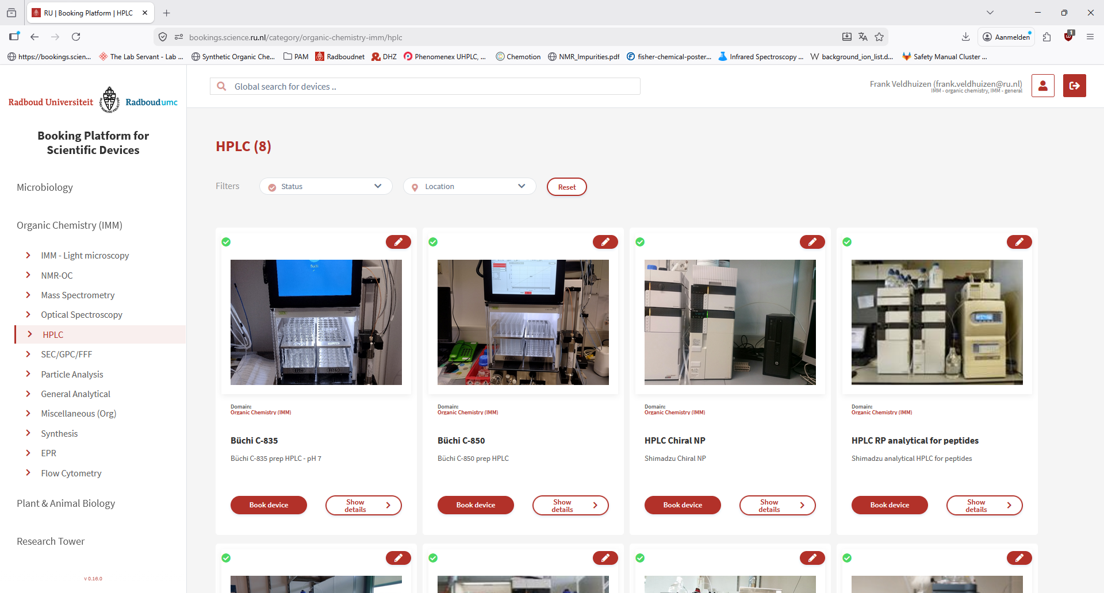
Booking system
Web page for reserving equipment
First time: log in, then send Frank/Dennis/JanZ an email requesting to activate your account

Slide 12
General lab safety
07/04/2026
Florian Ort (Safety Steward Wing 1 Huygens)
Milan Hoffmann (Safety Steward Mercator 3)
Notes:
Introduce & explain safety officers

Slide 13
Safety – Culture, not hierarchy
Safety is a collective responsibility
Help each other (constructively!)
If someone causes trouble, find help
The rules allow us to work (and we will be inspected)

Slide 14
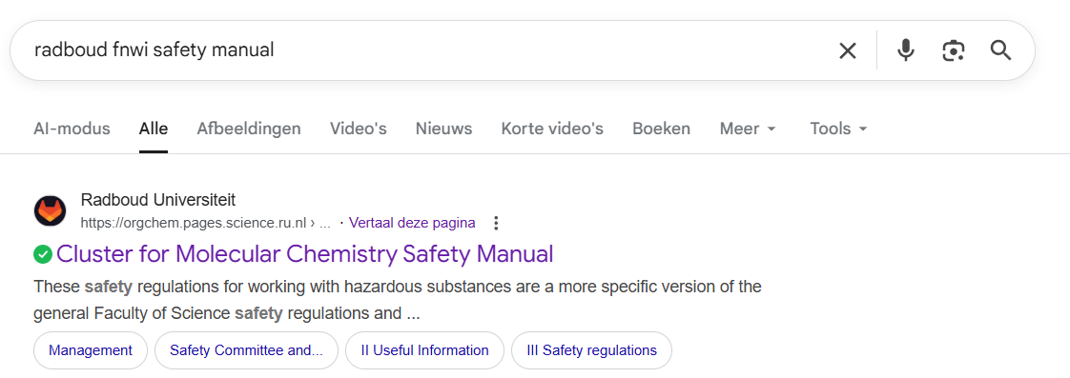
Safety manual & test
Safety manual (most up-to-date version) : https://orgchem.pages.science.ru.nl/safetymanual/

Slide 15
Safety manual & test
Organization of the Molecular Chemistry Cluster
Useful information
Safety regulations
When ready, the Safety Steward provides the test
Passed the test in 2025? No need for repetition

Slide 16
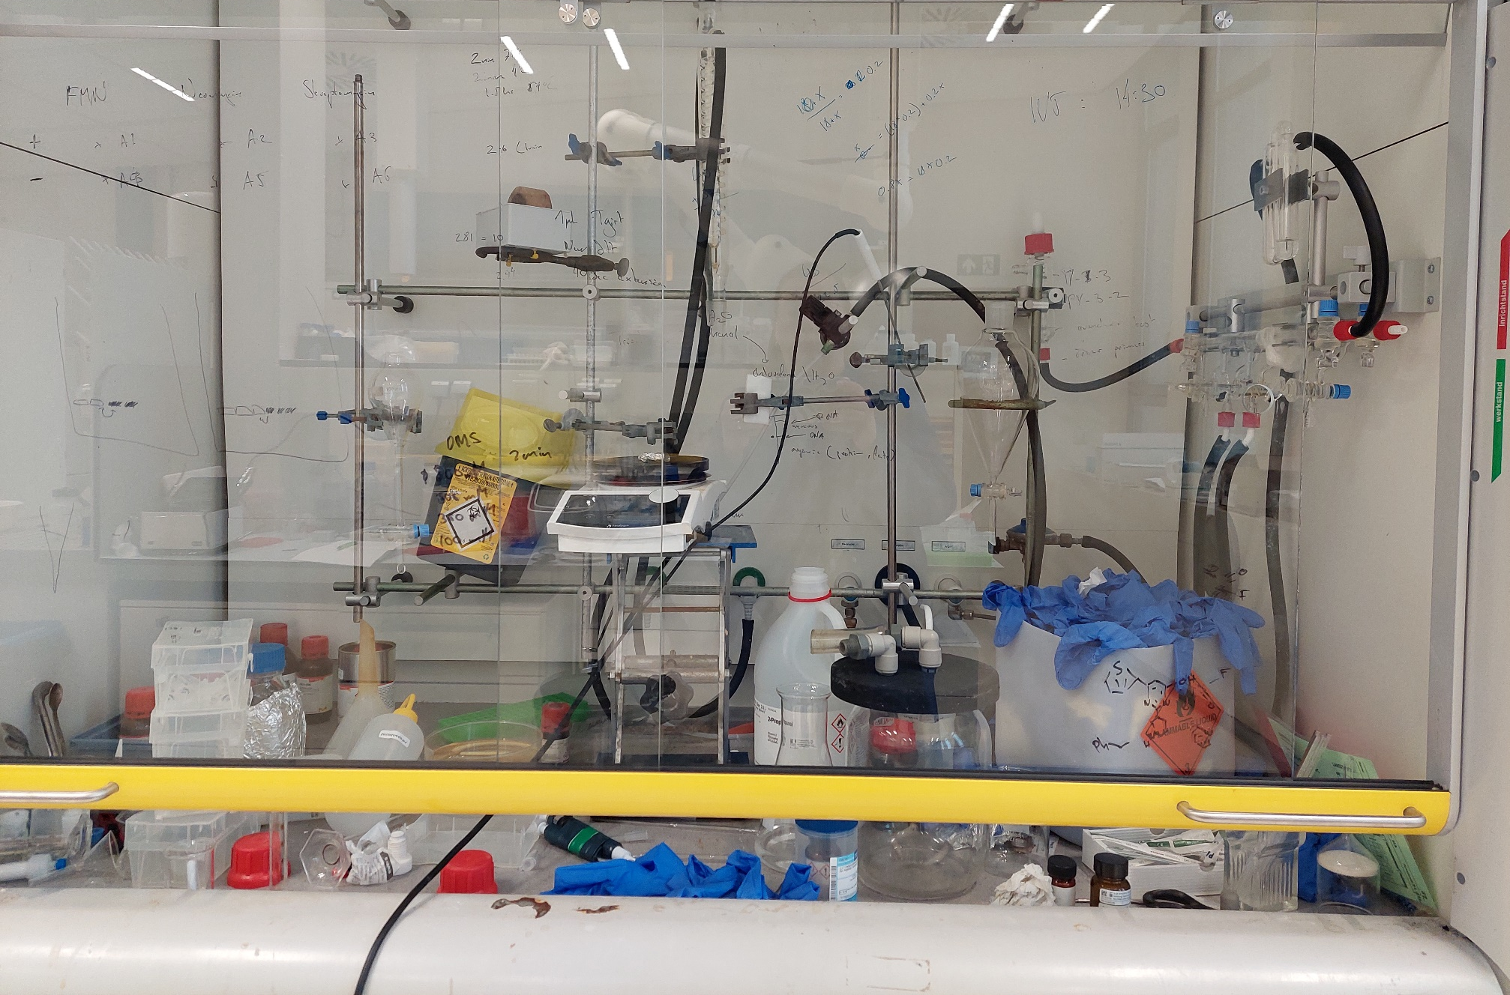
Working in a lab
Your fumehood = your responsibility
Your lab = joint responsibility (including regular cleaning)
Lab stewards
H03.109 – Florian Ort
H03.115 – Wiert Kolkman
H03.118 – Wessel Sinnige
H03.130 – Florian Zielke
M03.105 & M03.029 – Milan Hoffmann

Slide 17
Working in a lab
Lab steward (or another employee) closes the lab
Lab tour (by lab steward or employee)
Red buttons
First aid boxes
Emergency exits
Absorption material
Common instruments & devices
Emergency showers & Eye showers
Fire extinguishers (CO₂, sand, water, fire blanket, etc.)

Slide 18
Accidents
Notify your colleagues, supervisor and safety steward
Keep calm, limit the risk and inform others
Serious risk? Notify others, evacuate, 024 36 55555
First aid (EHBO)
Florian Ort
Samuel Bosma
Wessel Sinnige
Ellen van den Berg
Willem Titulaer (Mercator 3)

Slide 19
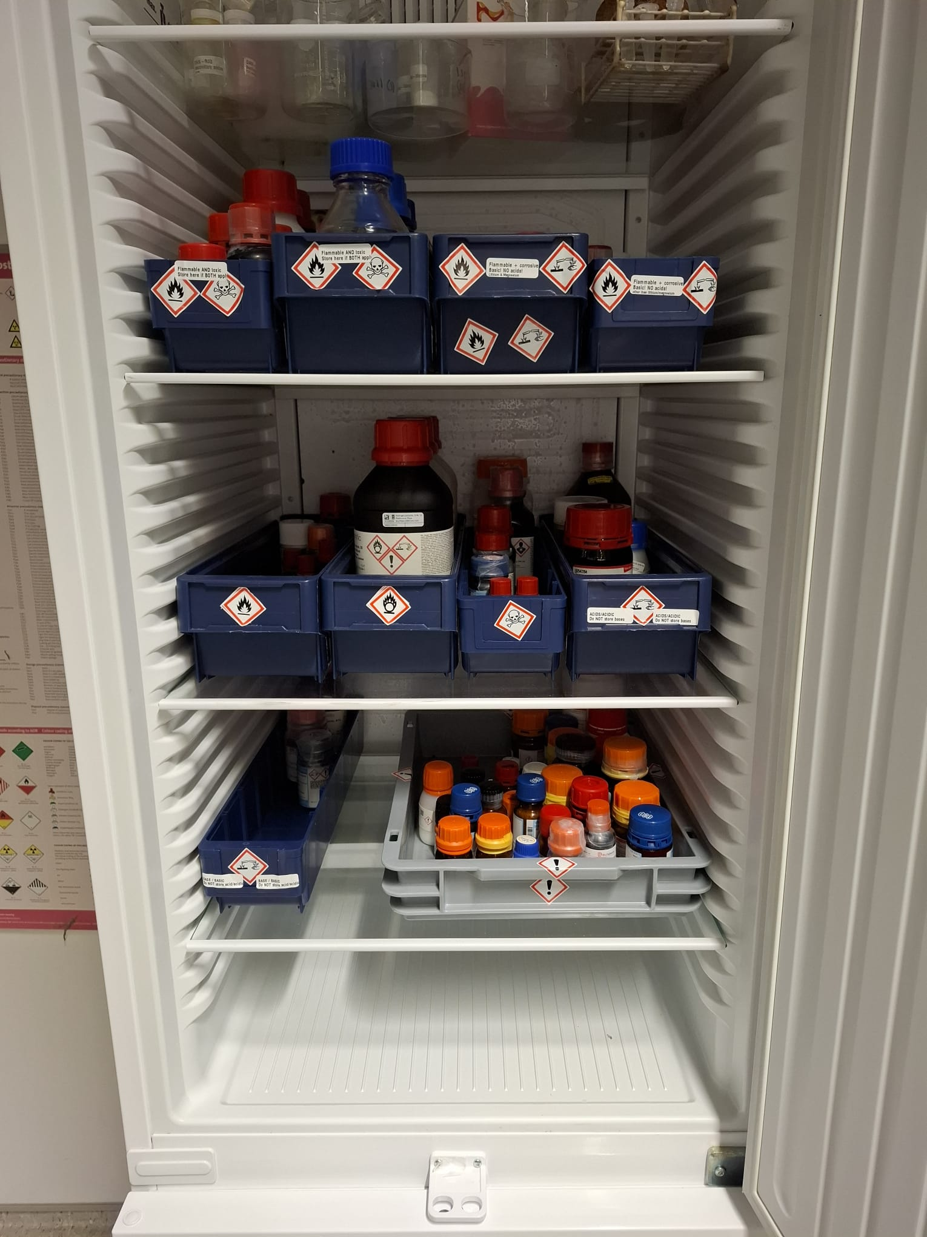
Chemical storage
Please store chemicals in
proper drip trays
Keep acids & bases separate
Keep oxidizers separate
Personal samples: Label correctly
Name
Date
Experiment number
Compound

Slide 20
A point about gloves…
Keep gloves in your fumehood
Spill = change
Chemical Permeation times are <1(0)s for most organic solvents
(alcohols 17 – 40 seconds)
They offer splash protection, if at all, nothing more!

Slide 21
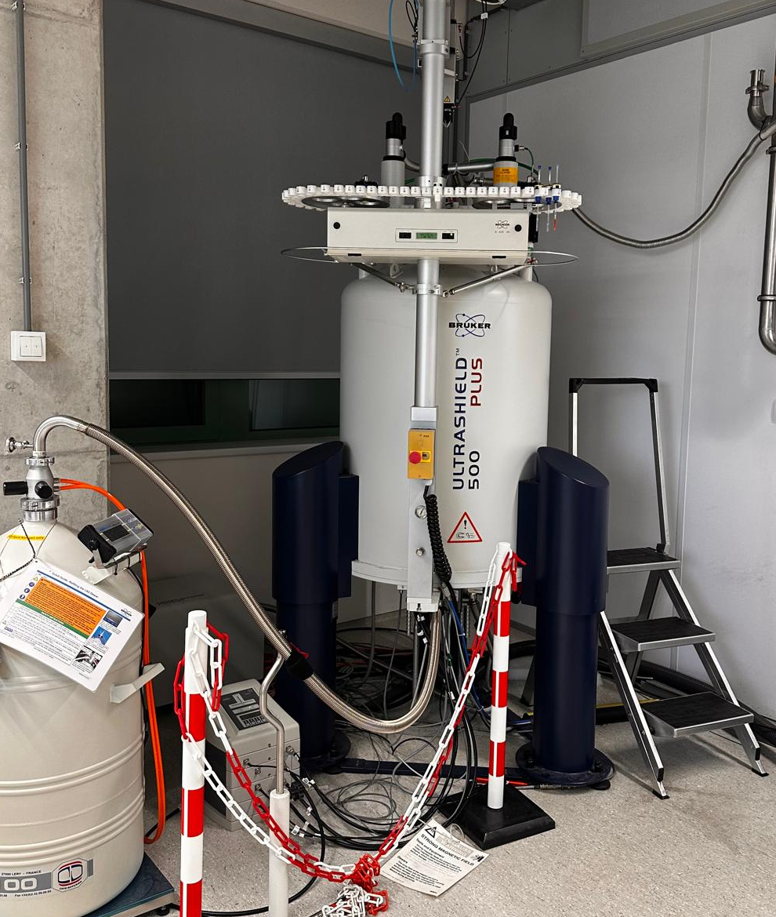
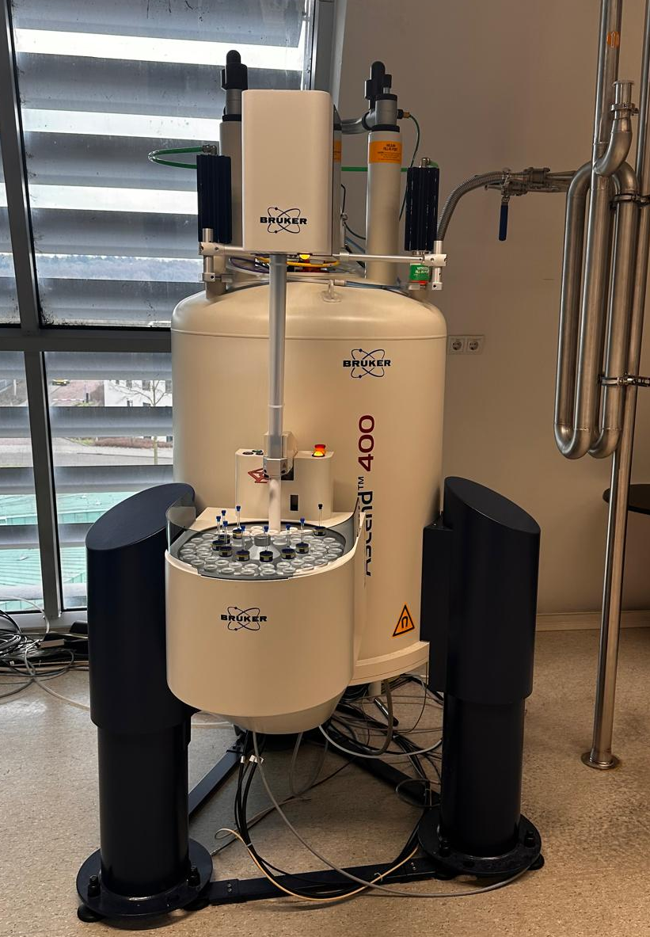
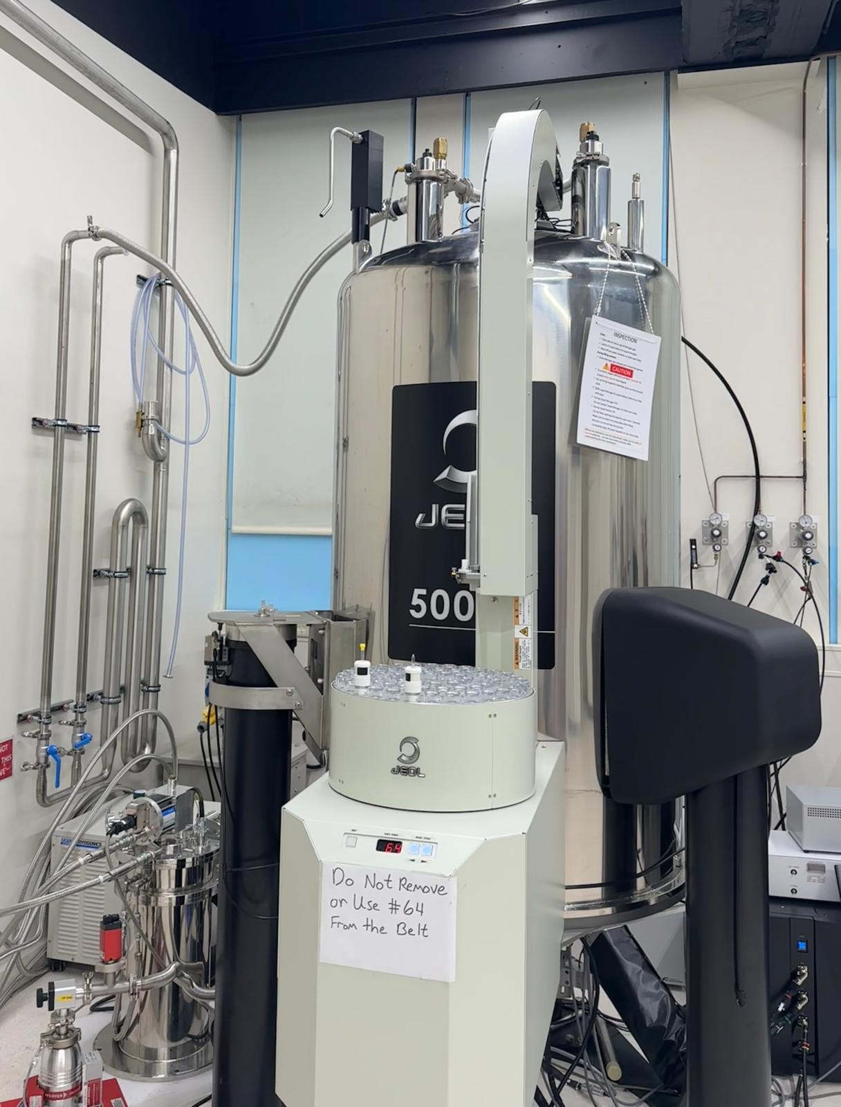
NMR Facility
B500-Prodigy probe
B400-iprobe
HFX and supercool probe
Access to 400–500 MHz NMR spectrometers
Supports nuclei ranging from ¹⁵N to ³¹P, as well as ¹H and ¹⁹F
Experimental Capabilities- 1D & 2D NMR for structure determination, Quantitative NMR and other advanced experiments
Magnets can be found in Mercator III and wing 4
Mandatory training is required -Sign-up link will be sent by email

Slide 22
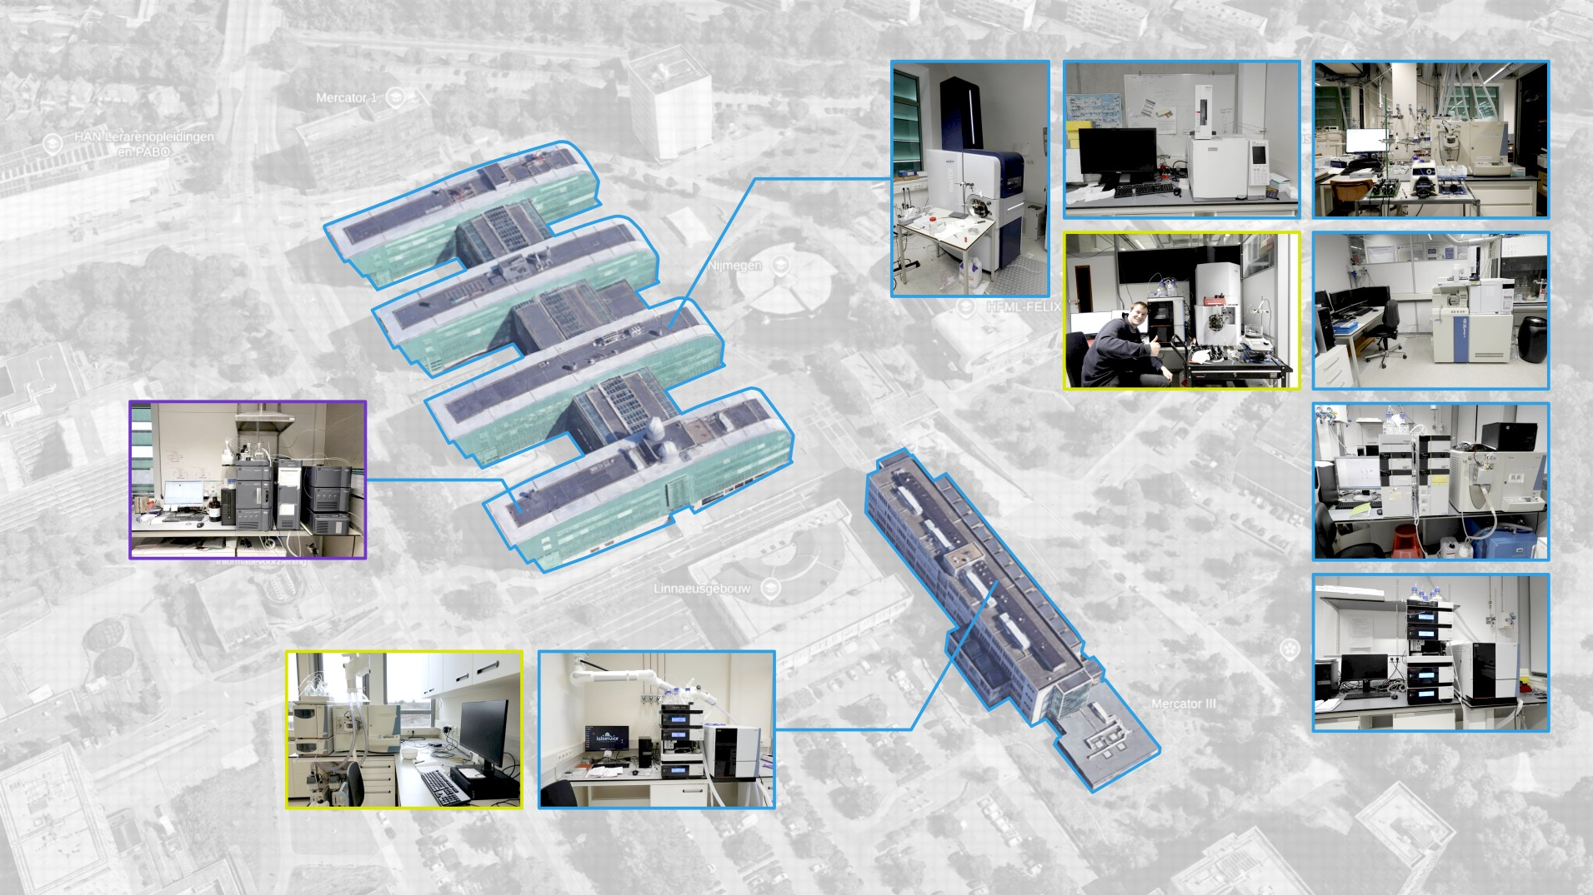
MS Facilities
• Shared facilities
• Group facilities
• Shared – scCO₂

Slide 23
MS facilities
Name | Group
Rau, N.M. (Niklas) | Neumann/Wilson
Knox, A.C. (Anna) | Huck
N.R.M. de Kler MSc (Noël) | Roithova
Moons, S.J. (Sam) | Synvenio
Poulladofonou, G. (Georgia) | Velema
Shaghaghi, B. (Behrad) | Kouwer
Schenker, R.W. (Robin) | Löwik/Rutjes
Sinnige, W. (Wessel) | Löwik/Rutjes
Berg, E.G.F. van den (Ellen) | Rutjes
Tyumina, A. (Angelina) | Spruijt/Huck
MS Tutors – primary contact persons
Imm-instruments.science.ru.nl
  Bit messy landing page, but the instrument pages themselves should be good cookbooks (if not, please ping me a mail! ☺)
  Should point you the right direction with most of your questions
Complex questions?
  Ping a mail
  Come, if I will have time, I will try my best to help you
HRMS? -> cookbook on the website

Slide 24
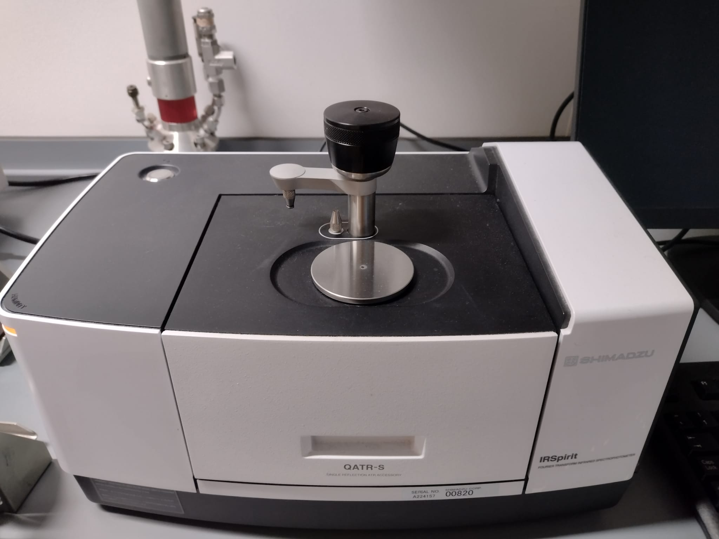
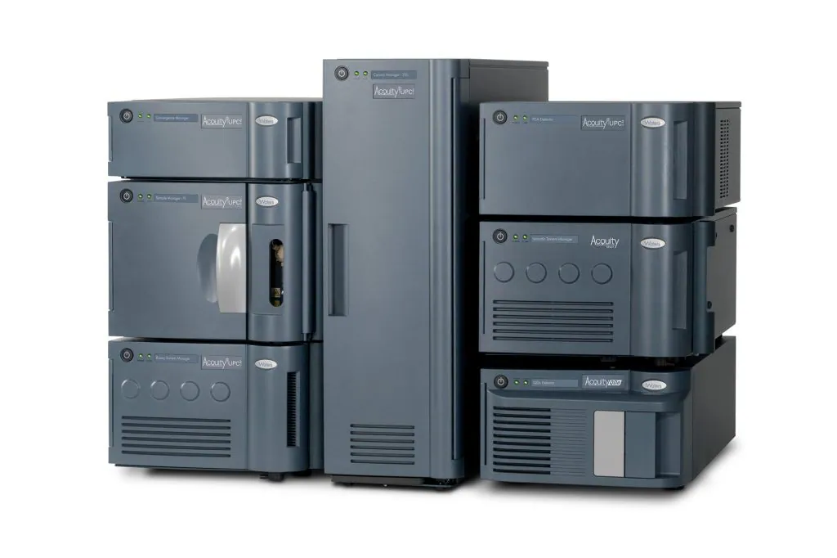
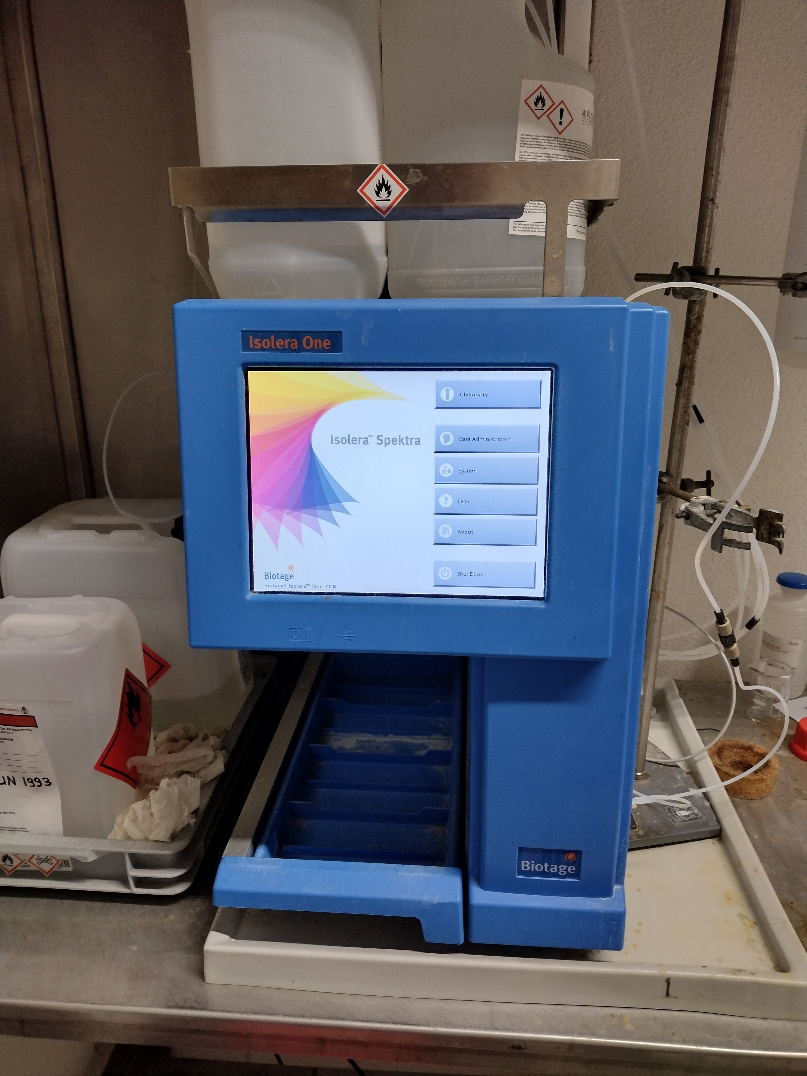
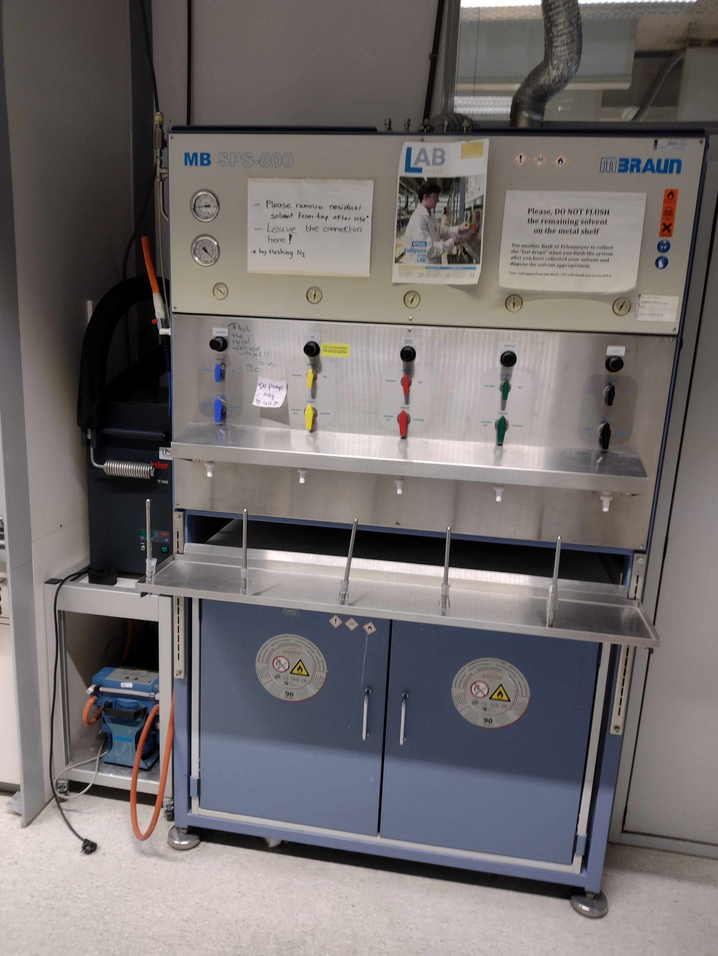
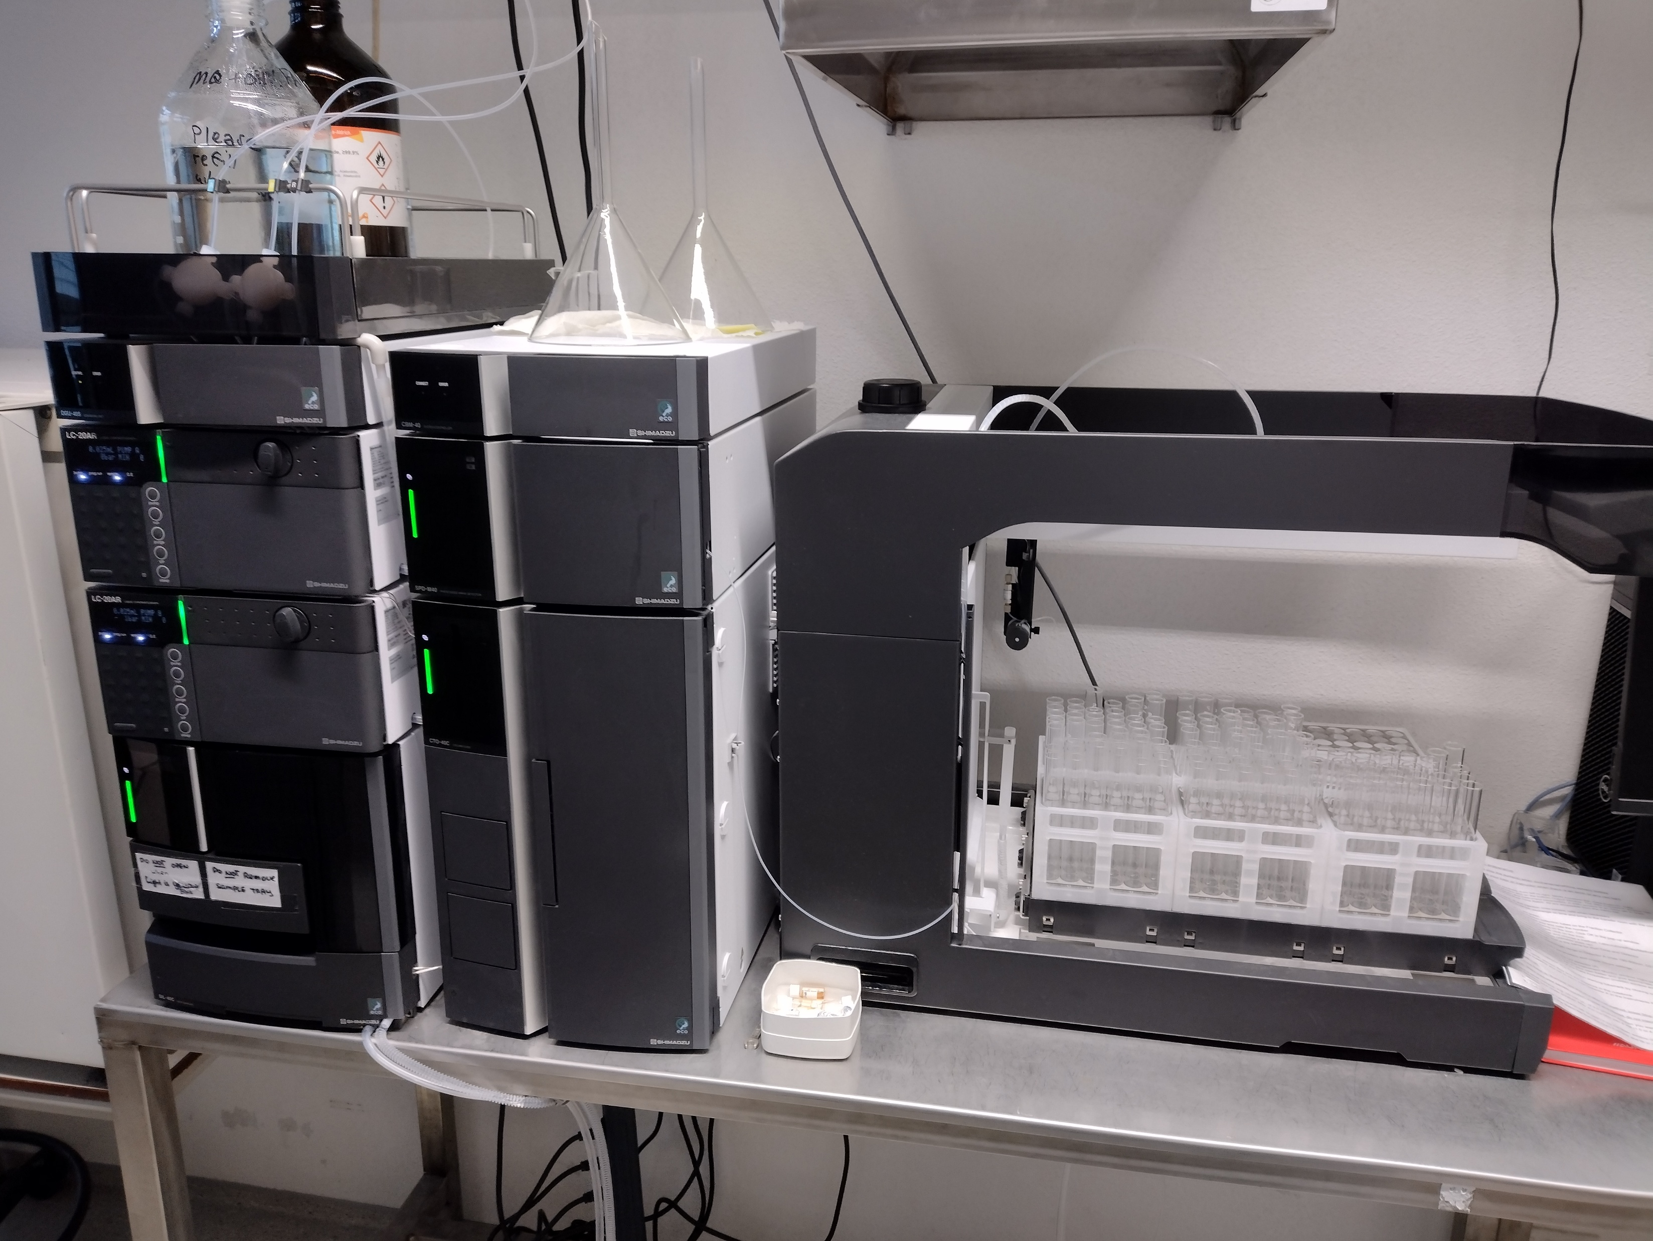
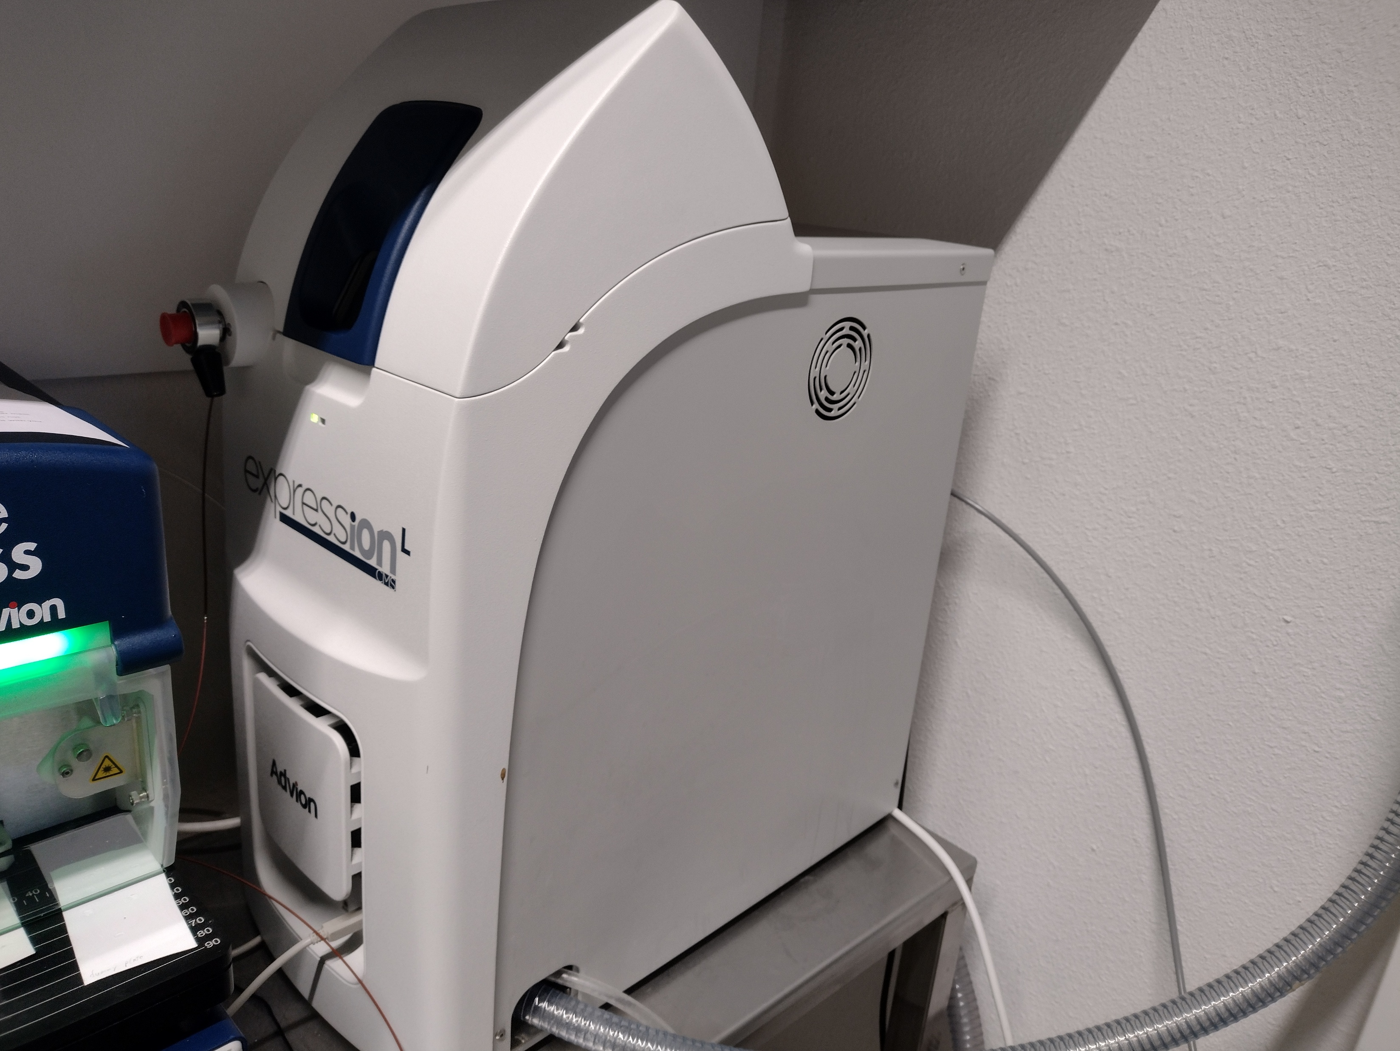
Equipment

Slide 25
Booking system
Web page for reserving equipment
First time: log in, then send Frank/Dennis/JanZ an email requesting to activate your account

Slide 26
Supercritical fluid chromatography (SFC)
Form of chromatography that uses supercritical fluid (e.g., CO₂) as mobile phase
  In combination eluents such as methanol, ethanol, isopropanol (+ acid/base)
Main use:
  For analysis and purification of low to moderate mol. weight compounds
  Thermally labile compounds
  Separation of chiral compounds
Mass detector available
Instrument can be found in wing 1, floor 3
Training: Frank Veldhuizen

Slide 27
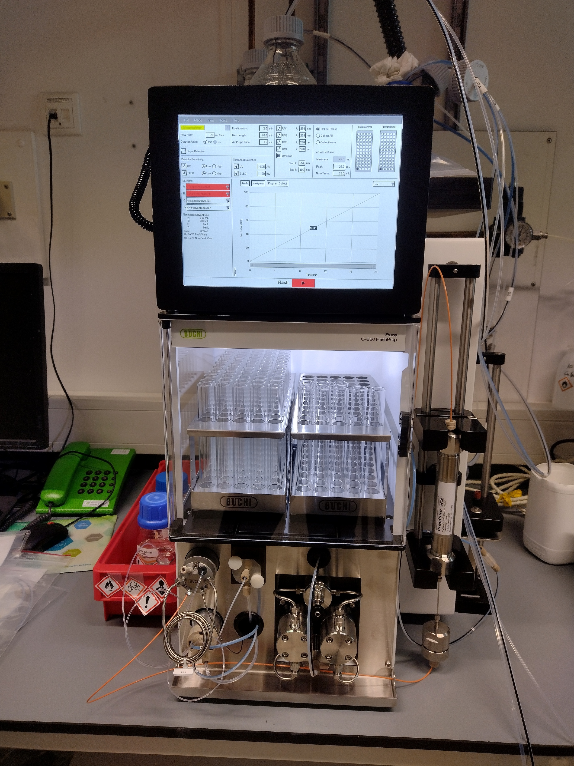
Preparative HPLC (Prep-HPLC) Büchi
Purification of final compounds
Automatic fraction collector
Instrument can be found in wing 1, floor 3
Training: Frank Veldhuizen

Slide 28
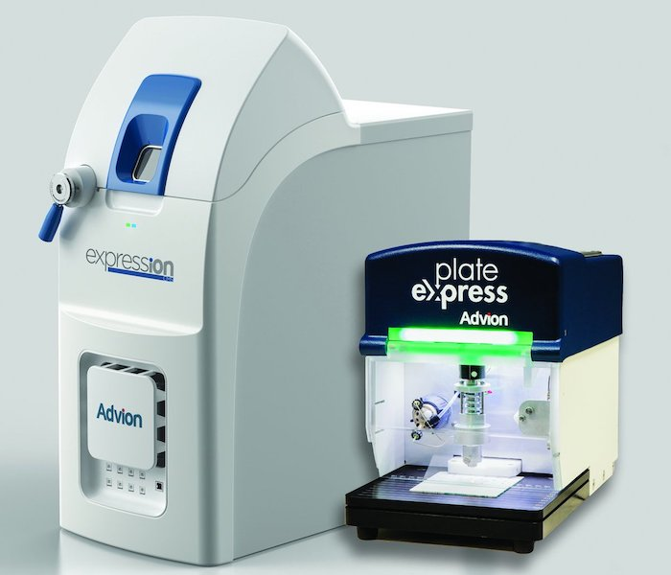
Thin-Layer Chromatography – Mass Spectrometry (TLC-MS)
Identify the mass of spots on a TLC plate
Rf value must be known and TLC plate should not be stained
Instrument can be found in wing 1, floor 3
Training: Frank Veldhuizen

Slide 29
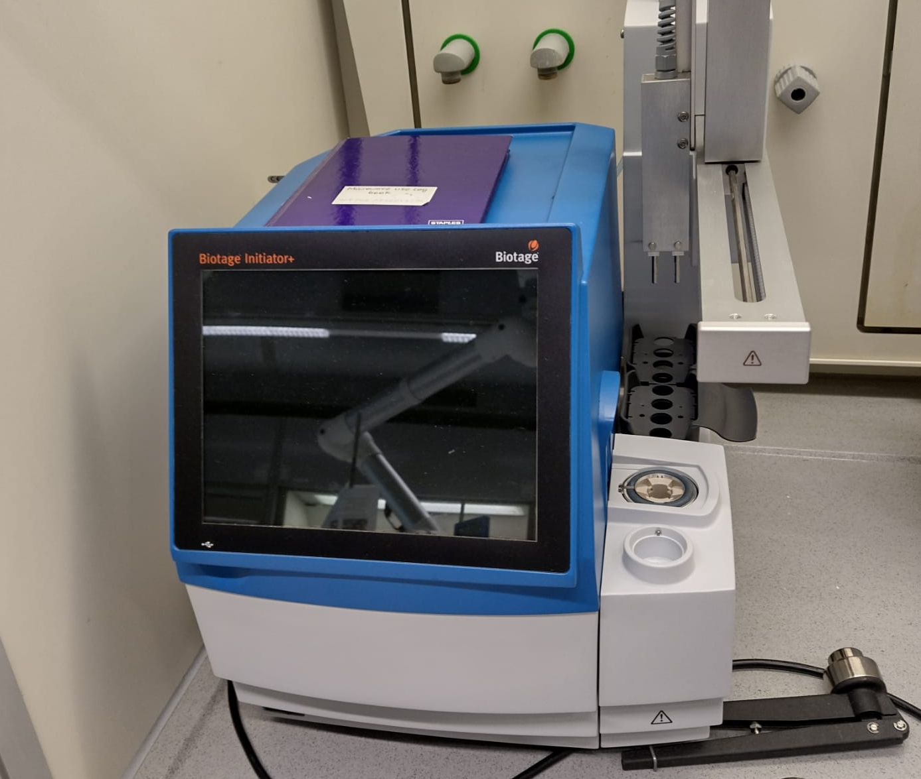
Biotage microwave synthesizer
Enables automated synthesis under demanding reaction conditions of up to 300 °C and 30 bar
Special glassware capable of withstanding high temperatures and high pressures is required
Huygens and Mercator
Training: Frank Veldhuizen

Slide 30
Infrared spectroscopy (IR)
Infrared measurements for characterization of functional groups causing molecular bonds to vibrate, stretch, and bend at specific frequencies
Instrument can be found in wing 2, floor 3
Training: Frank Veldhuizen

Slide 31
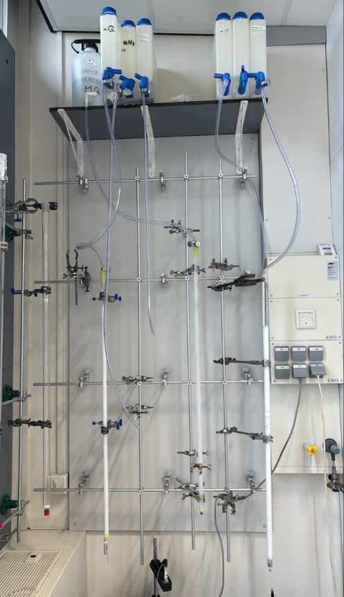
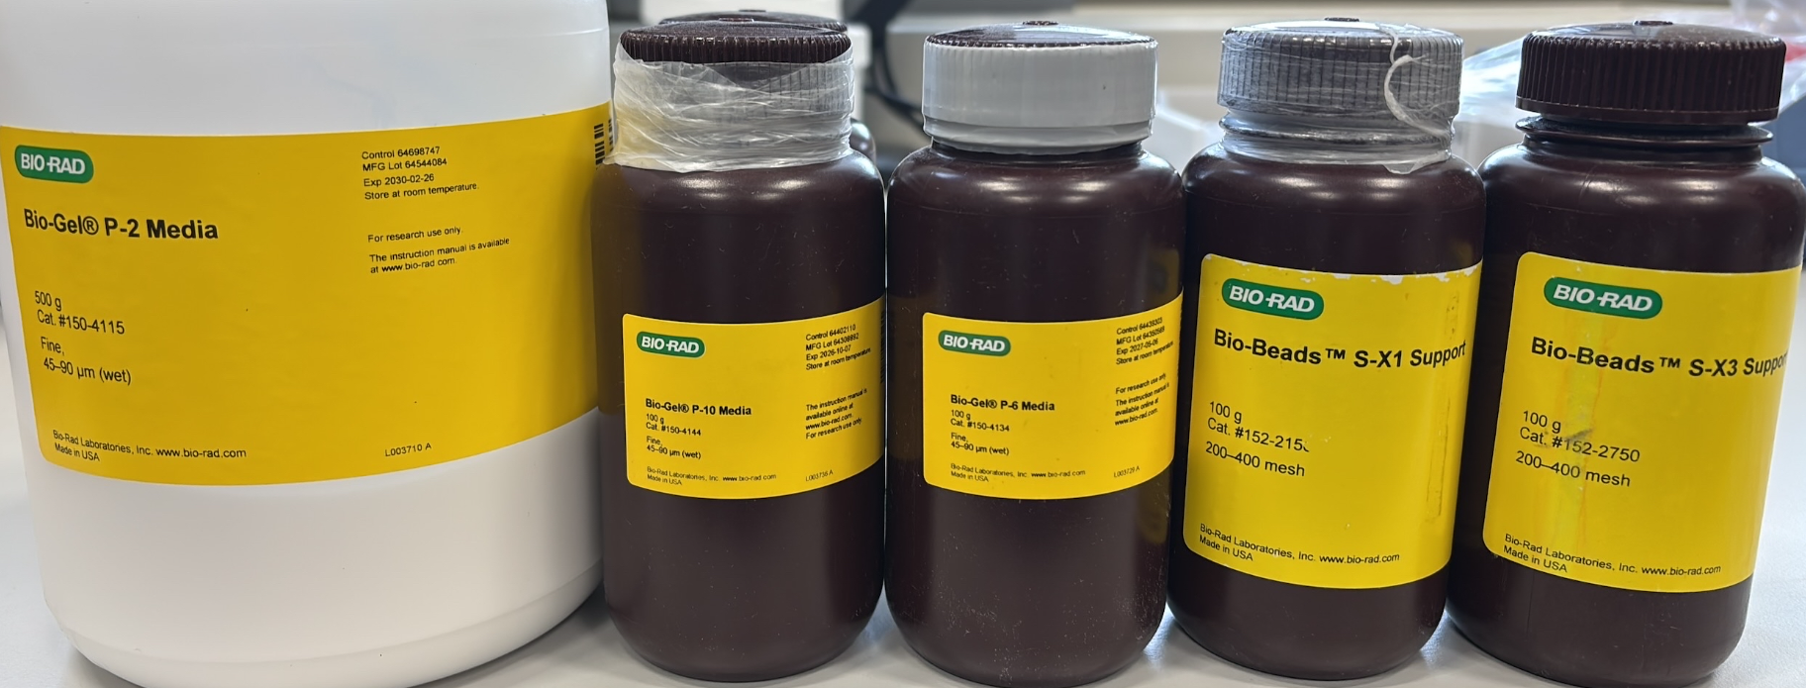
Size exclusion chromatography (SEC)
Purification of very polar high molecular weight compounds
Bring your own BioRad SEC beads, and discuss first with Thomas Boltje
Eluent systems:
  H₂O or ammonium buffers
  Organic solvents (DCM in special cases)
Setup can be found in Mercator III, floor 3
Training: Sam Moons & Milan Hoffmann

Slide 32
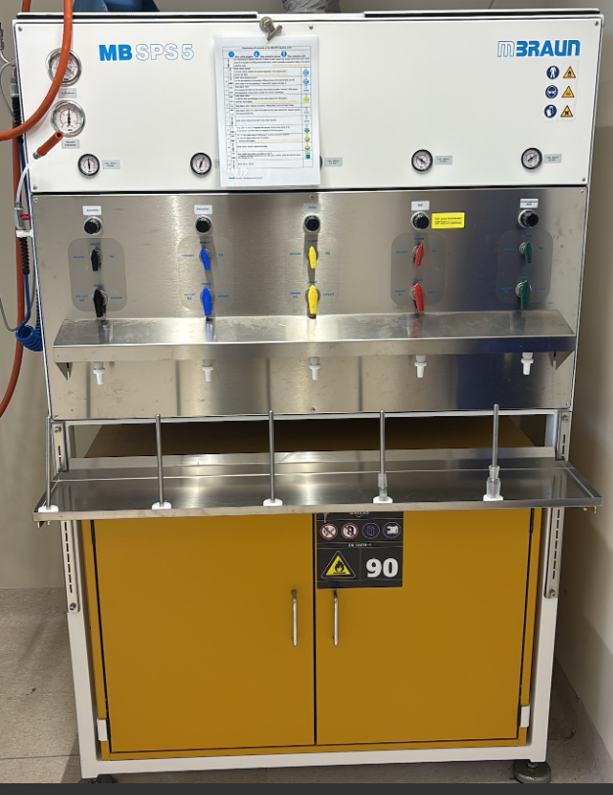
MBraun SPS 5 (Solvent Purification System)
When you require dry and de-oxygenated solvents.
  Acetonitrile
  Diethyl ether
  Toluene
  Tetrahydrofuran
  Dichloromethane
Reactions with dry conditions
Dispenser can be found in Mercator III, and wing 1
No solvent or low pressure? Ask Hernando/Jan to change the barrel
Training: your own supervisor

Slide 33
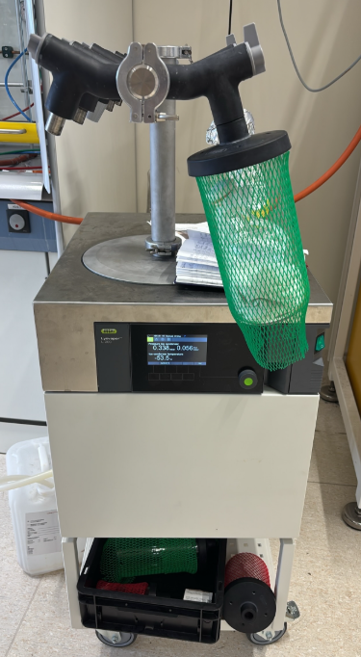
Freeze Dryers
Lyovapor 250 can be found in Mercator III
  -85 °C condenser coil
  Sublimation of ACN/H2O
  12 manifold positions
Scala Scientific can be found in Wing 4, floor 3
  -85 °C condenser coil
  Sublimation of ACN/H2O
Training: your own supervisor

Slide 34
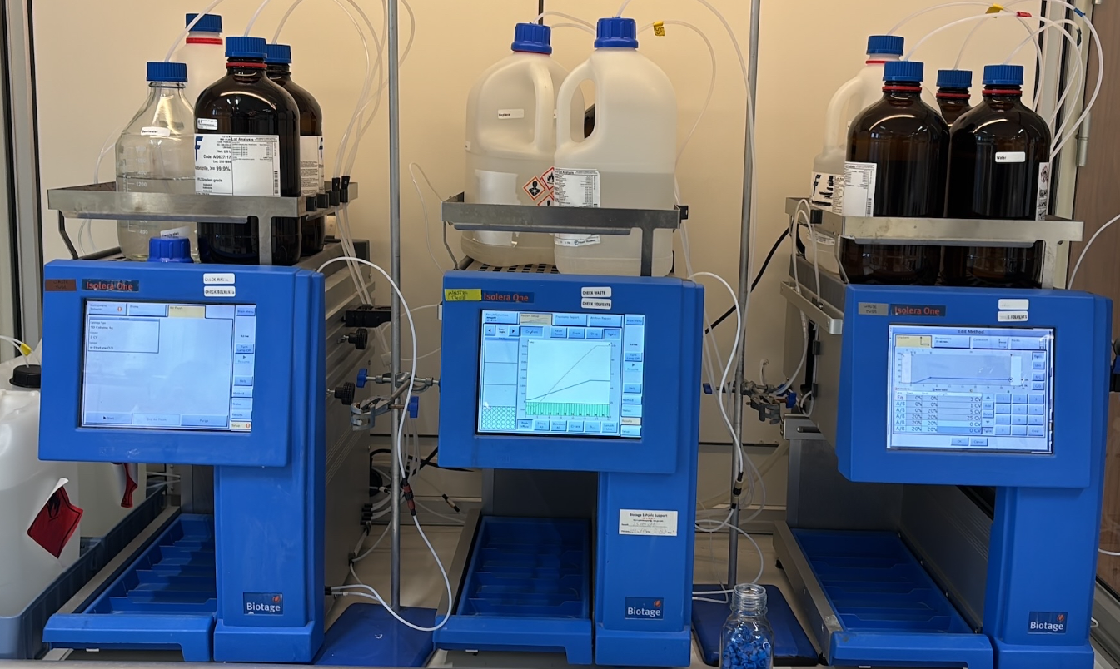
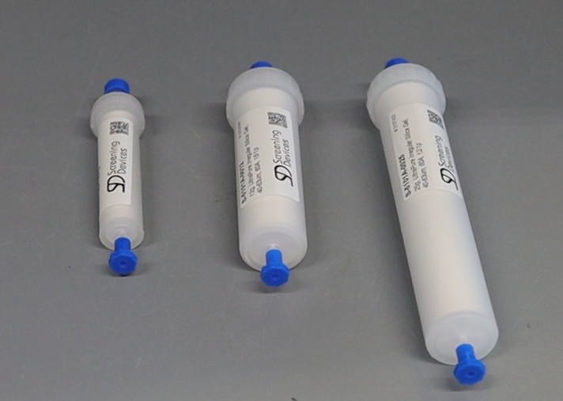
Biotage isolera flash chromatography system
Flash chromatography for the purification of crude material
Uses pre-packed silica columns (or RP – C18)
Learn how to use manual columns first to grasp the purification concept
Instruments can be found in Mercator III, and in wing 1
Training: your own supervisor

Slide 35
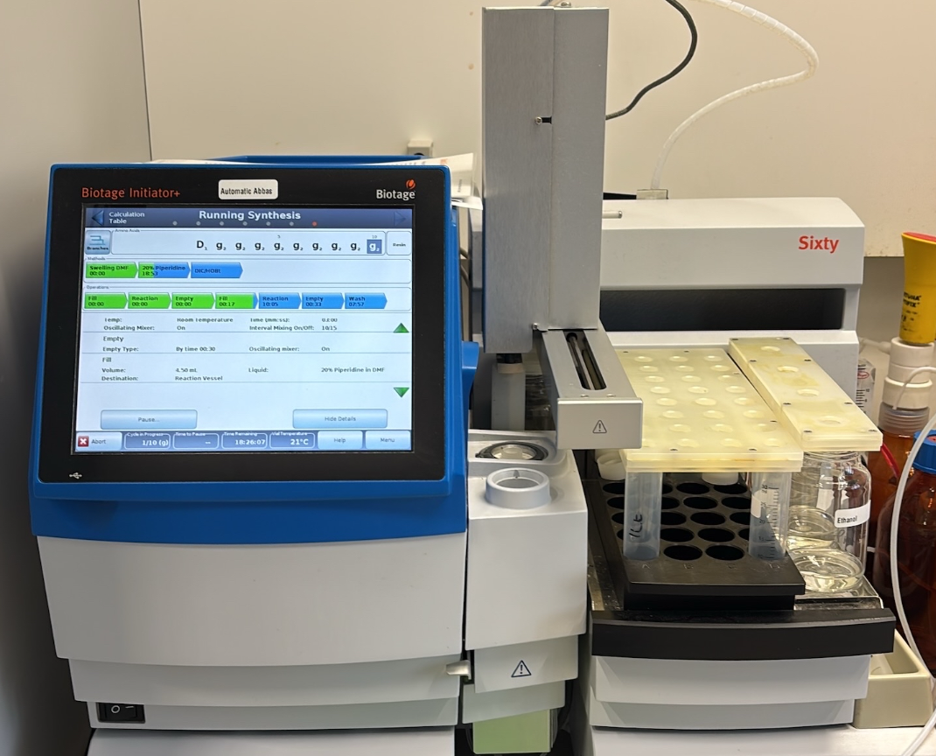
Biotage Initiator +
SPPS (Solid Phase Peptide Synthesizer)
Automated coupling of amino acids into peptides
Usually useful for long peptide sequences
Instrument can be found in Mercator III, Fumehood H1-2.
Training: Hernando Tuñon

Slide 36
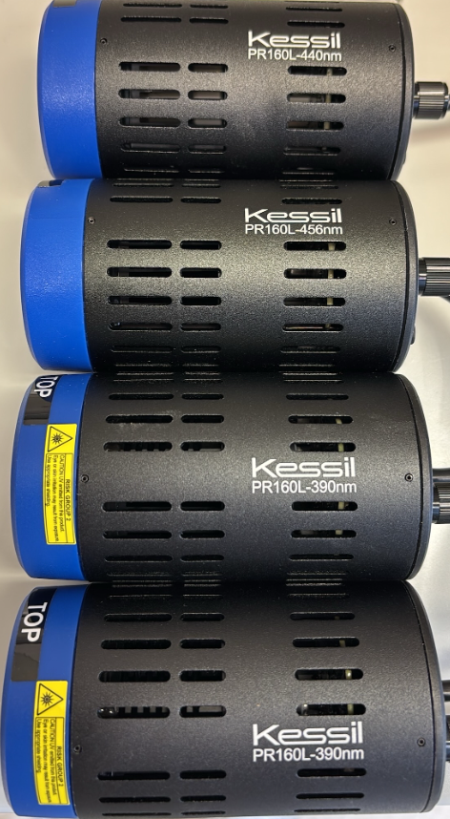
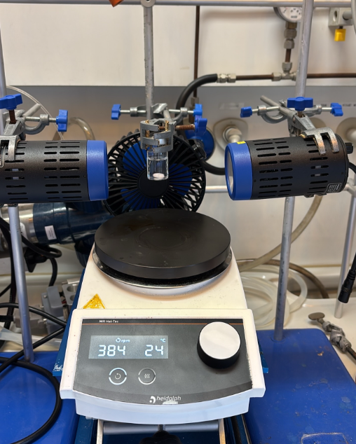

Photo chemistry
2x 390 nm, 1x 440, and 1x 456 nm kessil lamps for photo chemistry.
Setup can be found in Mercator III, Fumehood H1-1.
Training: Frank de Kleijne & Hernando Tuñon

Slide 37
Thank you for listening
Questions?
Good luck and enjoy!

